Slide 1
Diabetes prediction and classification
CAPSTONE PROJECT
Presented By:
JOSIN JOSE
COLLEGE OF ENGINEERING KALLOOPPARA ,KERALA
COMPUTER SCIENCE DEPARTMENT

Slide 2
OUTLINE
Problem Statement
Proposed System/Solution
System Development Approach (Technology Used)
Algorithm & Deployment
Result
Conclusion
Future Scope
References

Slide 3
Problem Statement
Diabetes, a prevalent metabolic disorder, poses serious health risks including cardiovascular diseases, kidney failure, and neuropathy if left untreated. Early detection plays a crucial role in enabling healthcare professionals to intervene promptly with preventive measures and personalized treatment plans, thereby mitigating the risk of complications and improving patient prognosis. Even today many individuals often receive a diabetes diagnosis at a later stage leading to delayed intervention and increased health complications. So an detection system is necessary.

Slide 4
Proposed Solution
This project focuses on developing a machine learning solution for the early detection and classification of diabetes, emphasizing its significant impact on patient health outcomes .
The system is trained using Indian PIMA dataset for diabetes as binary classification problem. It aims to predict the likelihood of an individual developing diabetes based on various parameters such as pregnancies, glucose levels, BMI, age etc.
In proposed system we use SVM (support vector machine) algorithm for the classification. Support Vector Machine (SVM) is a powerful supervised learning algorithm used for classification and regression tasks. It works by finding the optimal hyperplane that best separates different classes in a dataset. SVM aims to maximize the margin between classes, making it robust to outliers and effective in high-dimensional spaces.

Slide 5
System Approach
REQUIREMENTS
HARDWARE REQUIREMENTS
Processor : any processor above 500 MHz
Ram :4GB
Hard Disk :4GB
SOFTWARE REQUIREMENTS
O.S : windows7 or higher
Programming : python 3.6 and related libraries

Slide 6
Algorithm & Deployment
Algorithm Selection:
Support Vector Machine (SVM) is a powerful supervised learning algorithm used for classification and regression tasks. It works by finding the optimal hyperplane that best separates different classes in a dataset. SVM aims to maximize the margin between classes, making it robust to outliers and effective in high-dimensional spaces. .
Dataset:
Pima Indian Diabetes dataset used here has 9 attributes in total. All the person in records are females and the number of pregnancies they have had has been recorded as the first attribute of the dataset. Second is the value of Plasma glucose concentration a 2 hours in an oral glucose tolerance test and then is the Diastolic blood pressure (mm Hg), fourth in line is the Triceps skin fold thickness (mm), then is the 2-Hour serum insulin (mu U/ml), sixth is Body mass index (weight in kg/ (height in m) ^2) and then seventh is the Diabetes pedigree function and the second last value is the that of the Age (years). The ninth column is that of the Class variable (0 or 1), 0 for no diabetes and 1 for the presence.

Slide 7
Algorithm & Deployment
Training Process:
The SVM algorithm is trained using historical data through the following steps:
Data Preprocessing: Before training the SVM model, the data is preprocessed. This includes standardizing the features using StandardScaler. Standardization ensures that all features have a mean of 0 and a standard deviation of 1, which helps in bringing all features to a similar scale and prevents features with larger magnitudes from dominating the model training process.
Train Test Split: The dataset is split into training and testing sets using the train_test_split function. This step is crucial to evaluate the model's performance on unseen data. By reserving a portion of the data as the testing set, the model's ability to generalize to new, unseen data can be assessed.
Training the Model: The SVM classifier is instantiated with a linear kernel and then trained on the training data using the fit method. During training, the SVM algorithm optimizes the hyperplane that best separates the data points into different classes (diabetic or non-diabetic) while maximizing the margin between the classes. The objective is to find the hyperplane that maximizes the margin and minimizes classification errors.
Model Evaluation: After training, the accuracy of the model is evaluated using both the training and testing data. This step helps assess the model's performance in terms of its ability to correctly classify instances from the training data (training accuracy) as well as unseen instances from the testing data (test accuracy). Accuracy score is calculated using the accuracy_score function from sklearn.metrics.
Specific considerations and techniques employed in the training process:
Train Test Split: The dataset is split into training and testing sets using the train_test_split function. This ensures that the model's performance is evaluated on unseen data, providing a more realistic assessment of its generalization ability.
Hyperparameter Tuning: In this code, the SVM model is instantiated with a linear kernel without explicitly tuning hyperparameters

Slide 8
Algorithm & Deployment
PREDICTION PROCESS
Standardization of Input Data: Before making predictions, any new input data (features of individuals) must be standardized using the same scaling parameters (mean and standard deviation) as the training data. This ensures consistency in feature scaling between the training and prediction phases.
Feature Extraction and Transformation: The input data (features) are extracted and transformed into the format expected by the trained SVM model. This typically involves reshaping the input data and applying the same transformations (e.g., standardization) as done during training.
Prediction: Once the input data is standardized and transformed, the trained SVM model is used to predict the target variable (diabetes outcome) for each instance. The SVM model predicts the class labels (0 for non-diabetic, 1 for diabetic) based on the learned decision boundary (hyperplane) and the input features.
Decision Making: The predicted class labels (0 or 1) represent the model's decision regarding the diabetes status of the individuals. Depending on the application, these predictions can be further interpreted or used for making informed decisions regarding patient care, intervention strategies, or healthcare resource allocation.

Slide 9
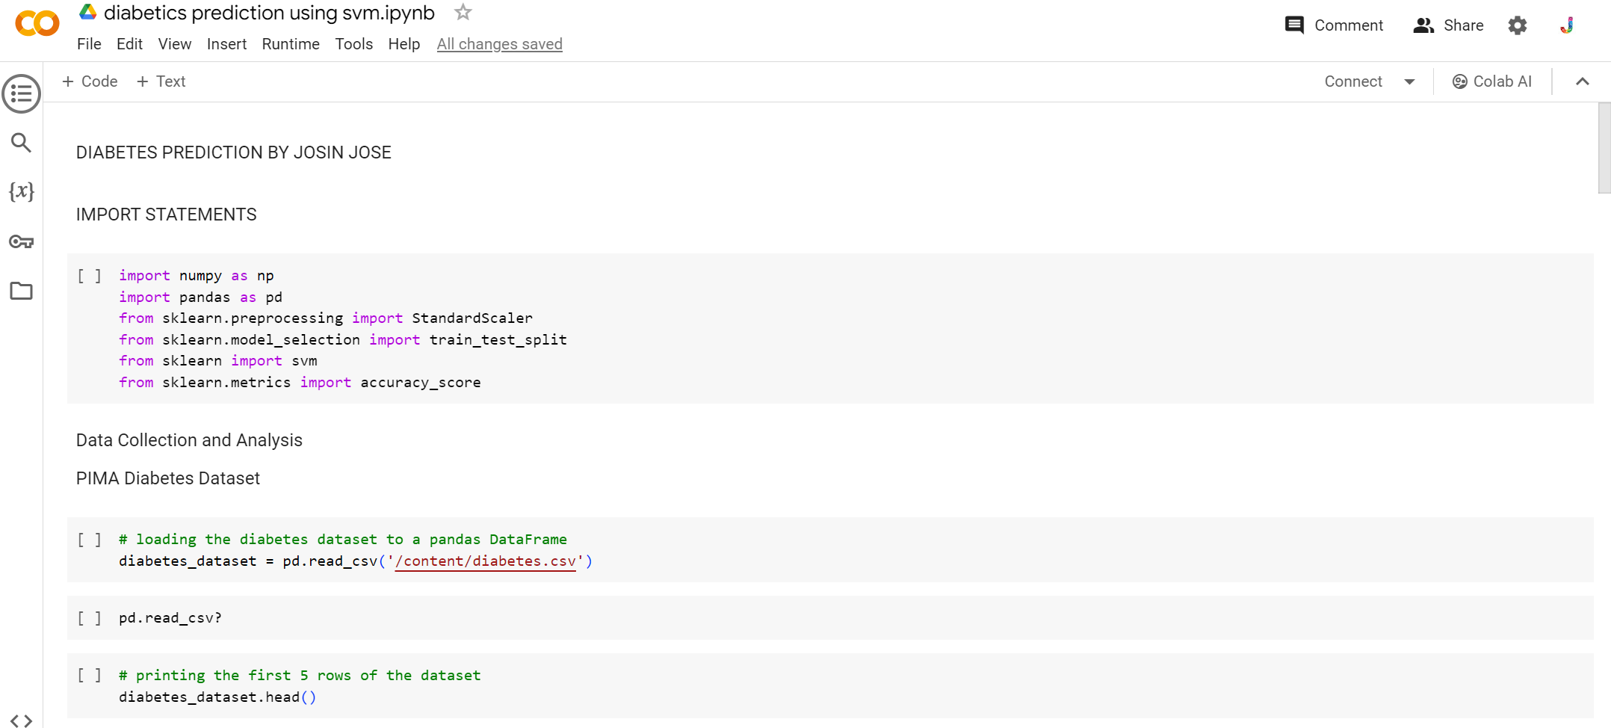
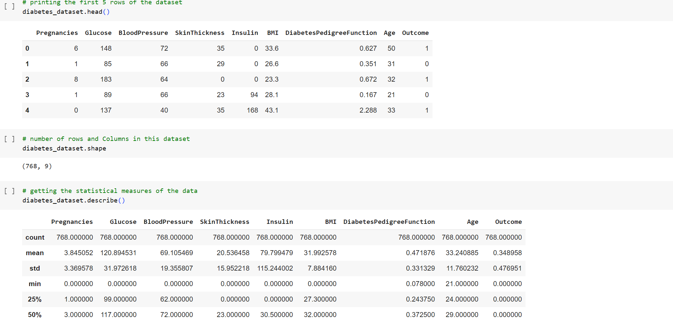
CODE AND Result

Slide 10
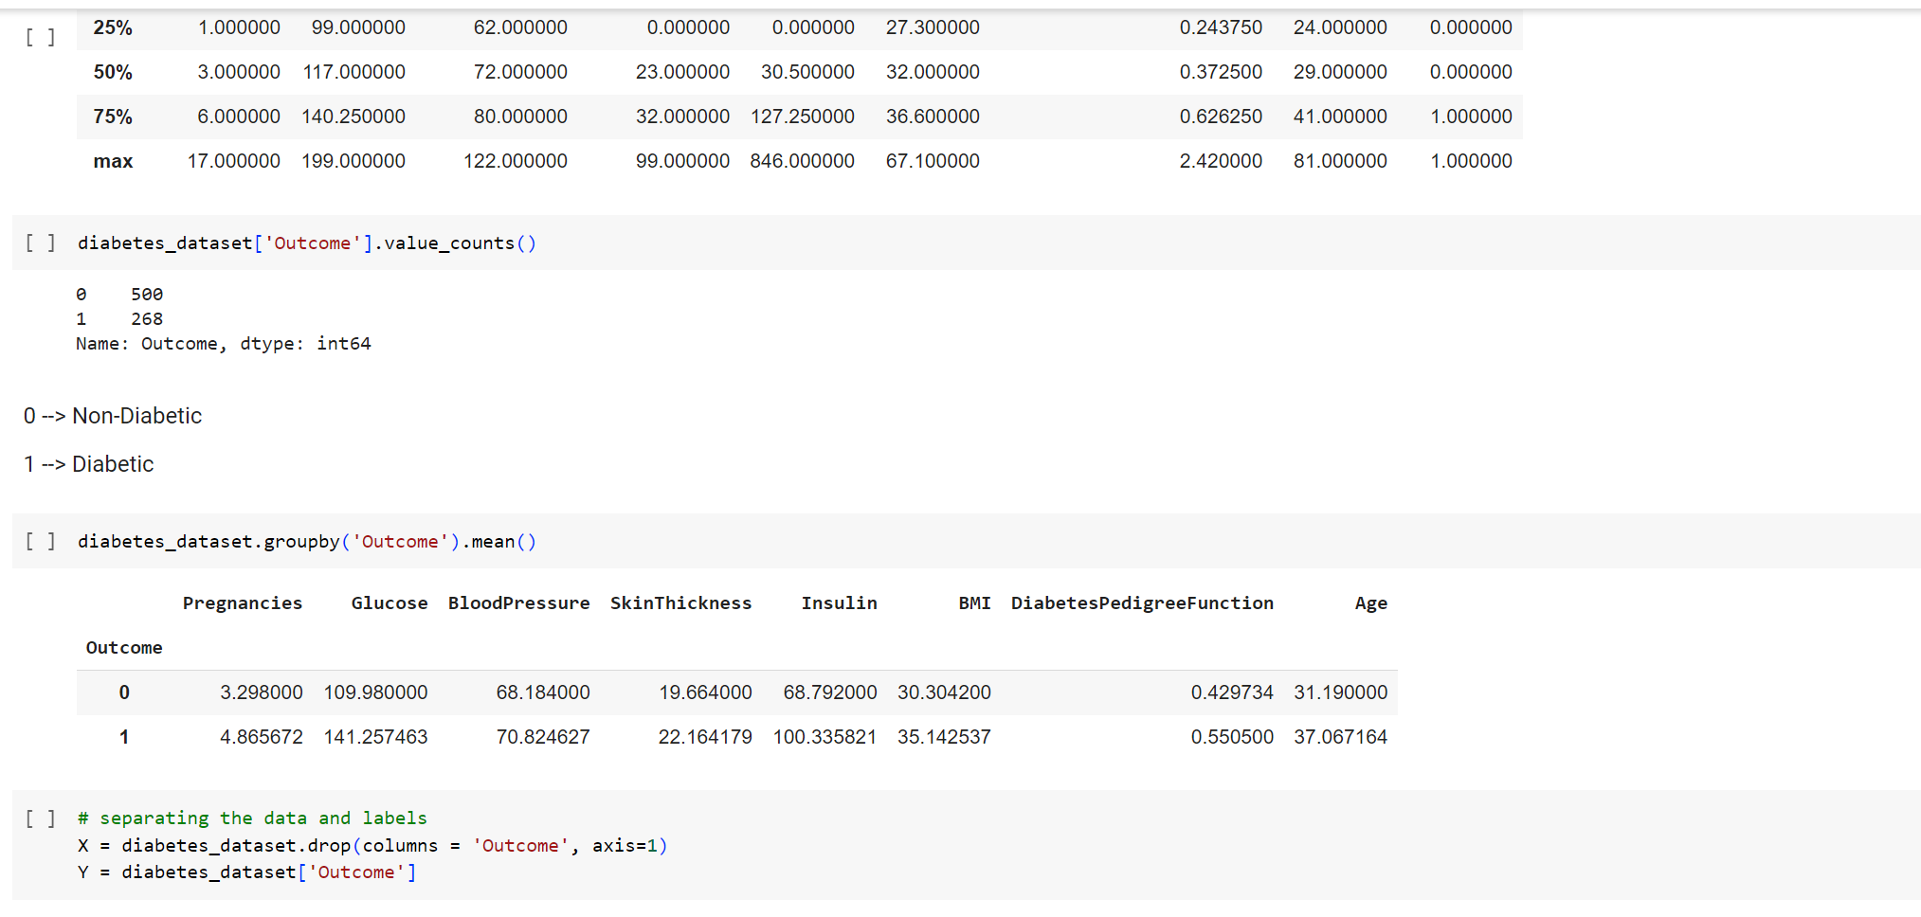
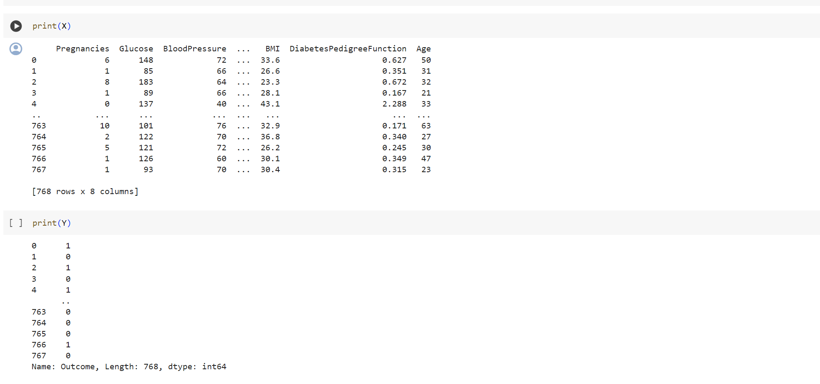
CODE AND Result

Slide 11
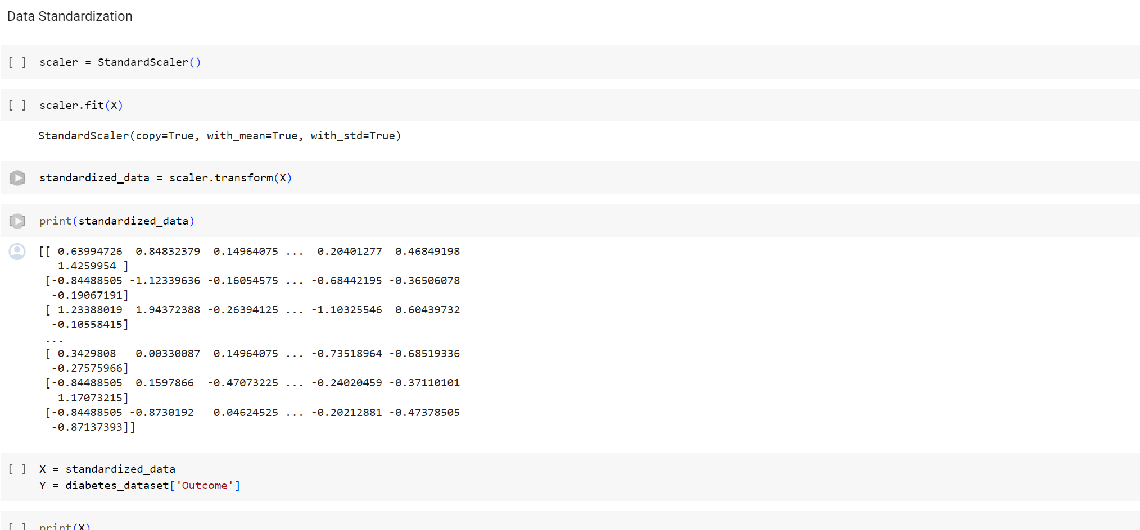
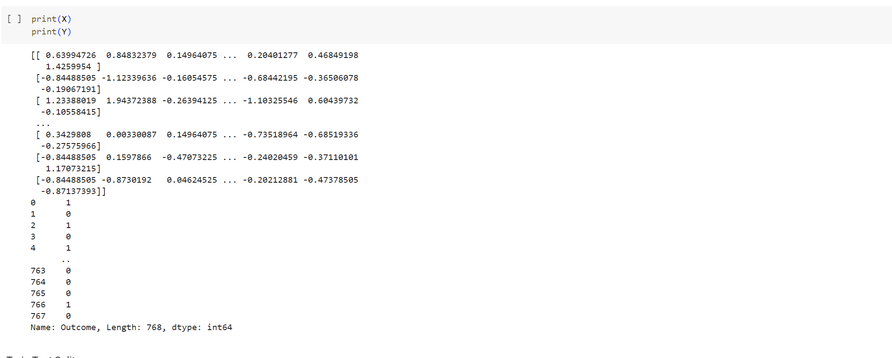
CODE AND Result

Slide 12
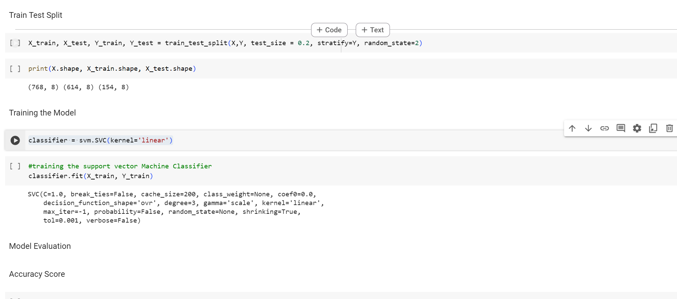
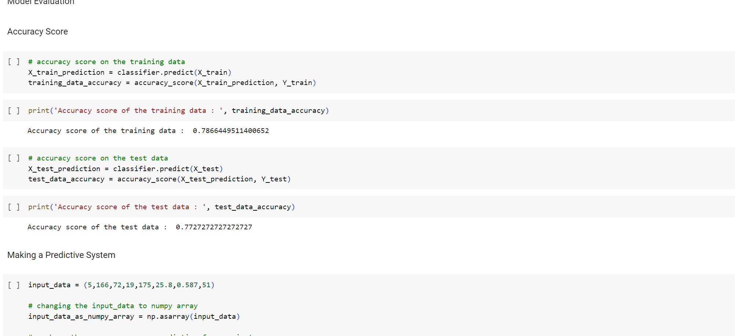
CODE AND Result

Slide 13
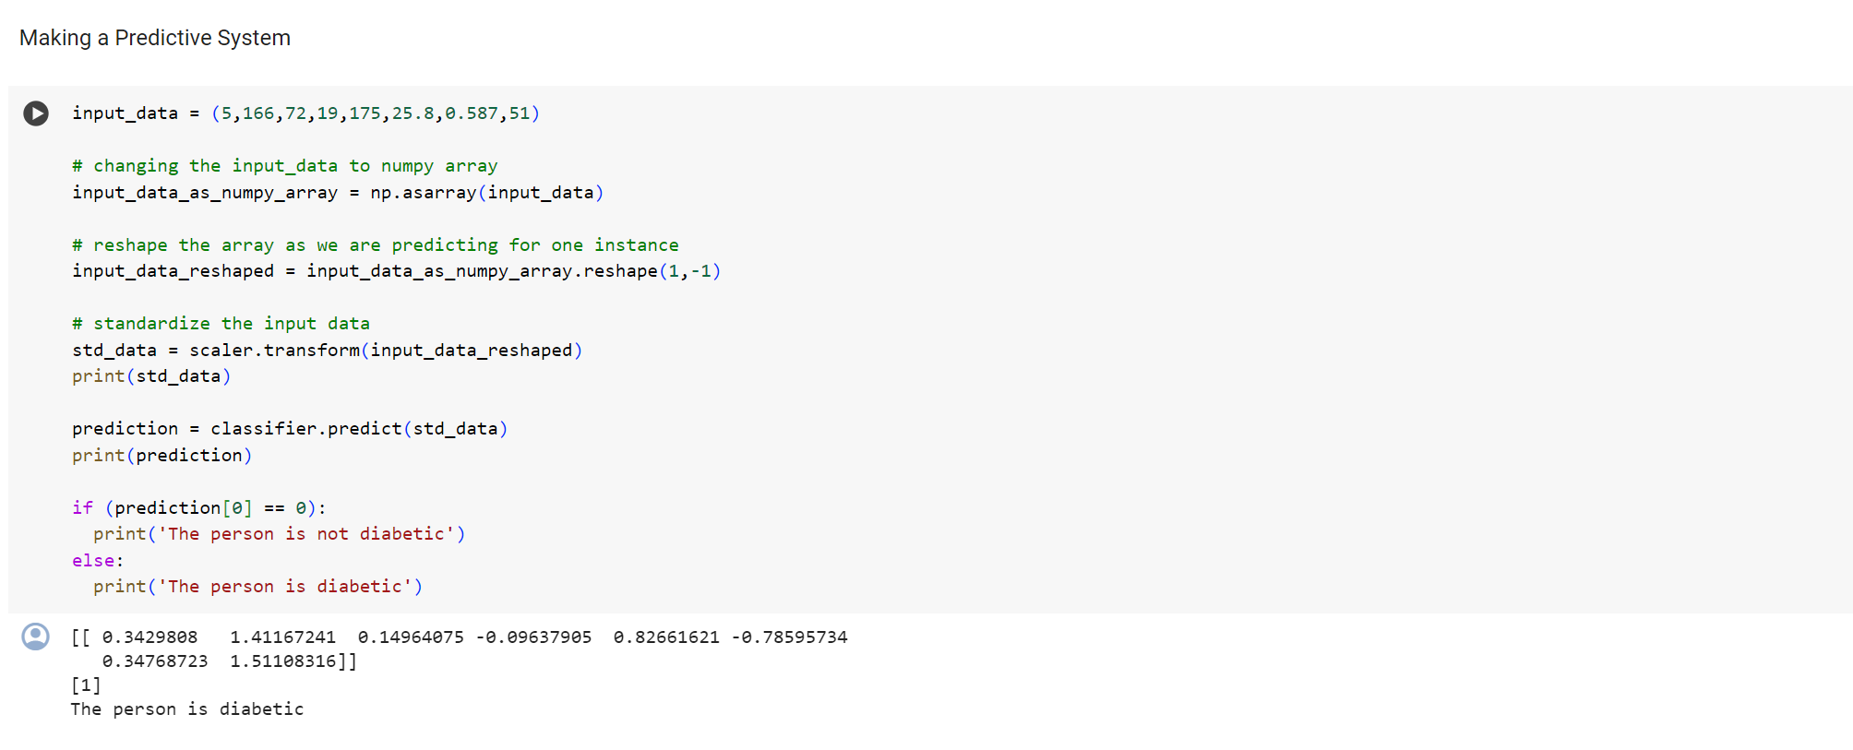
CODE AND Result

Slide 14
Conclusion
In conclusion, the utilization of Support Vector Machine (SVM) algorithms for diabetes prediction showcases significant potential in enhancing early detection and personalized healthcare interventions. By leveraging historical data encompassing demographic details, medical history, and clinical measurements, our solution demonstrates effectiveness in accurately predicting diabetes onset. Through timely intervention and tailored treatment strategies facilitated by accurate predictions, we aim to mitigate the risk of complications and improve overall patient outcomes. Moving forward, continuous refinement and collaboration with healthcare professionals are imperative to ensure the seamless integration of predictive models into clinical practice, thereby advancing patient care and wellness.

Slide 15
Future scope
In the realm of diabetes prediction, numerous avenues for advancement and expansion present opportunities for improving disease management and patient outcomes. Integrating additional data sources, such as genetic information and dietary/lifestyle factors, holds promise for enhancing the predictive power of the model. Optimization of algorithm performance through exploration of diverse kernel functions, implementation of ensemble methods, and feature selection techniques can further refine the accuracy and generalization capabilities of the system. Expanding the system's scope to include multi-class classification for diabetes subtypes, predictive analytics for complications, and real-time monitoring with personalized feedback will enable a more comprehensive approach to diabetes care. Moreover, ensuring ethical and regulatory compliance, addressing biases, and fostering collaboration with healthcare professionals are crucial steps toward deploying a robust and clinically relevant diabetes prediction system. By embracing these advancements, we can pave the way for more effective disease management strategies and improved patient care.
.

Slide 16
References
[1]. Aljumah, A.A., Ahamad, M.G., Siddiqui, M.K., 2013. Application of data mining: Diabetes health care in young and old patients. Journal of King Saud University - Computer and Information Sciences 25, 127–136. doi:10.1016/j.jksuci.2012.10.003.
[2]. Arora, R., Suman, 2012. Comparative Analysis of Classification Algorithms on Different Datasets using WEKA. International Journal of Computer Applications 54, 21–25. doi:10.5120/8626-2492.
[3]. Bamnote, M.P., G.R., 2014. Design of Classifier for Detection of Diabetes Mellitus Using Genetic Programming. Advances in Intelligent Systems and Computing 1, 763–770. doi:10.1007/978-3-319-11933-5.
[4]. Choubey, D.K., Paul, S., Kumar, S., Kumar, S., 2017. Classification of Pima indian diabetes dataset using naive bayes with genetic algorithm as an attribute selection, in: Communication and Computing Systems: Proceedings of the International Conference on Communication and Computing System (ICCCS 2016), pp. 451–455.
[5]. Dhomse Kanchan B., M.K.M., 2016. Study of Machine Learning Algorithms for Special Disease Prediction using Principal of Component Analysis, in: 2016 International Conference on Global Trends in Signal Processing, Information Computing and Communication, IEEE. pp. 5–10

Slide 17
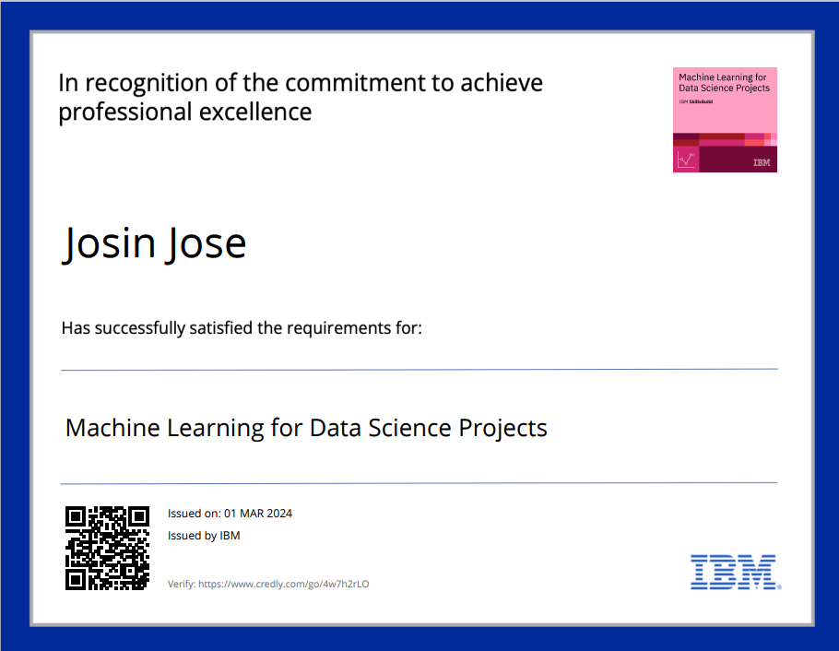
course certificate 1

Slide 18
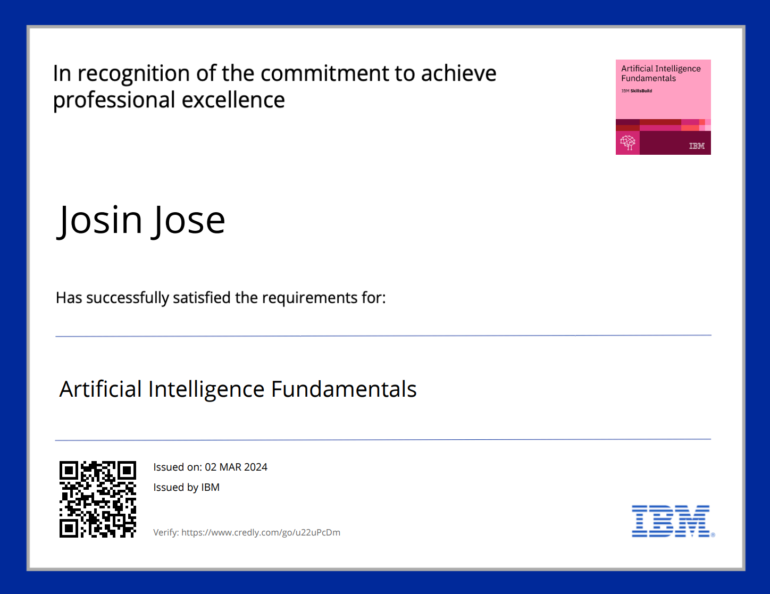
course certificate 2

Slide 19
THANK YOU

